Slide 1
EXPOSYS DATA LABS
MEETUP
An app based on common interest.
Developed By : Masupalli Yuktha Priya

Slide 2
Contents
Project Objective
Introduction
Features
Software Requirements
Modules
System Diagram
Conclusion
References
Future Enhancement

Slide 3
Project Objective
To develop an interactive android app which provides :
Chatting
Latest News Update
Information or Content Sharing

Slide 4
Introduction
MEETUP is an android application, which can help people to get so much information about their interest and can bind people who has similar interest.
MEETUP is combination of News App and Social Media App.
MEETUP contains all news regarding user’s interest through out the world.
MEETUP user’s can share their valuable knowledge with each other through social media functionality.
MEETUP is easily adaptable and it’s a user friendly application.

Slide 5
Features
Simple and Friendly User UI
Secure Login.
Content Sharing Method.
Latest News and Current Affairs.
7 Different Categories of Interest.
Options to interact with content.
Social Media Integration.

Slide 6
Software Requirements
Android API level 24 and higher.
Standard Development Kit(SDK).
Permissions
INTERNET
ACCESS_NETWORK_STATE
ACCESS_WIFI_STATE

Slide 7
Tools and Technology
I Tools :
Android Studio.
Firebase.
JDK.
II Technology :
Java
III API :
News API.

Slide 8
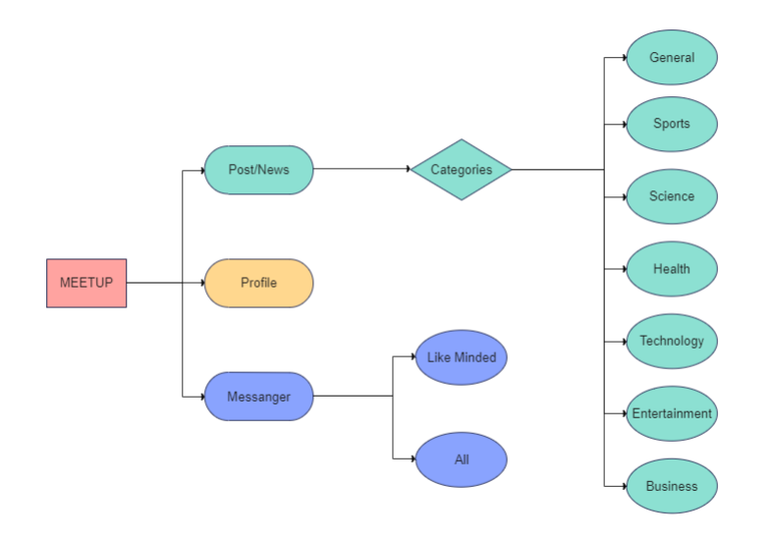
System Diagram

Slide 9
Conclusion
MEETUP is a powerful tool which can help you to enhance knowledge about various categories such as Science, Technology, Business, Health. Can make you to be up to date. MEETUP can increase your visibility, enhance relationship, establish two way communication between users. Keep in touch with friends and extended family, enhance social life.

Slide 10
References
https://developer.android.com/docs
https://firebase.google.com/docs
https://newsapi.org/docs

Slide 11
Future Enhancement
Data Encryption.
Location Based Service.
Notification Alert.
Extra Features (Audio, Video and Image Sharing, Video Call).

Slide 12
Thank You

